Slide 1
How to lie with statistics
Abhilash J

Slide 2



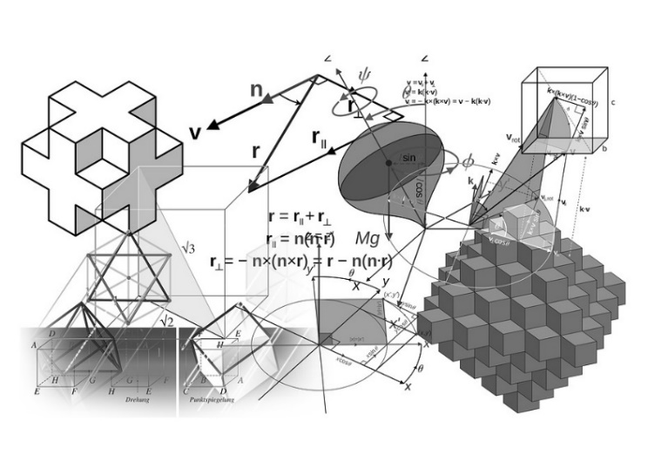
Lying through
visualizations
Lying about relationships
p-value
Lying with
confidence
Lying Using
Sophistication in Techniques

Slide 3
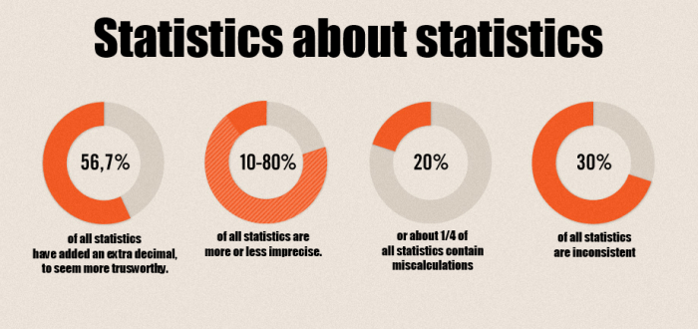
Source: http://bullisandco.com/statistics-youre-doing-it-wrong/

Slide 4
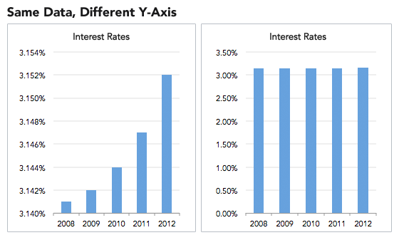
Truncating the Y-Axis to exaggerate the effect
Source: http://data.heapanalytics.com/how-to-lie-with-data-visualization

Slide 5
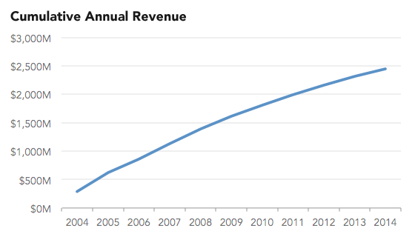
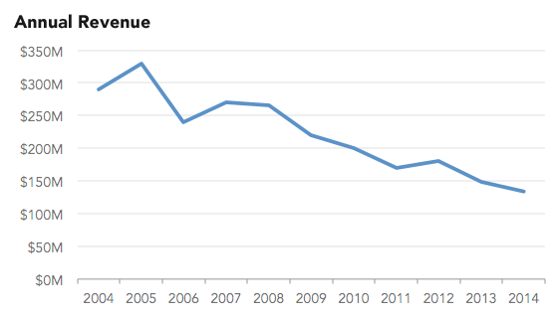
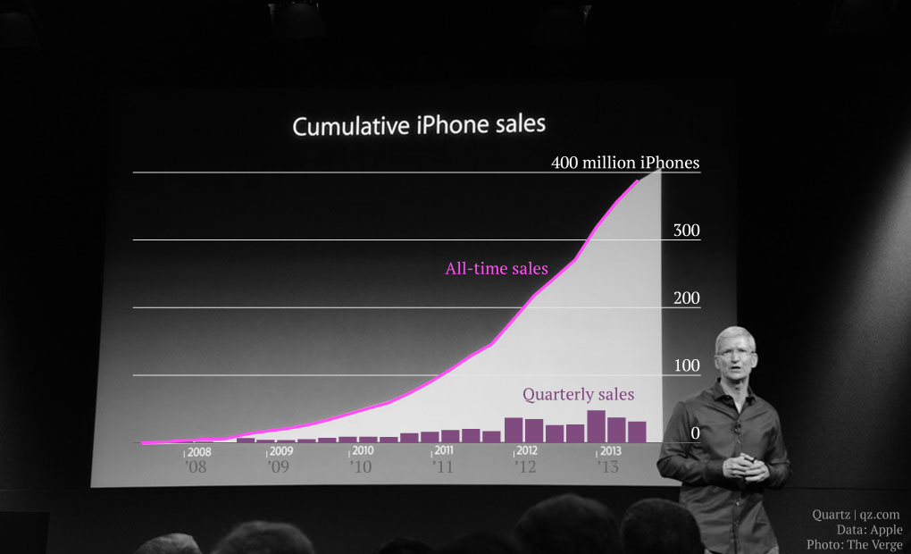
Using cumulative graphs to paint a different picture
APPLE using this technique at their 5s presentation:
http://qz.com/122921/the-chart-tim-cook-doesnt-want-you-to-see/
Source: http://data.heapanalytics.com/how-to-lie-with-data-visualization

Slide 6
3D pie charts are really useful to convey magnitude intuitively
20%
40%
Notes:
Anything wrong with this slide?
Not the typo, but the fact that both pies have 30% for Smaller but you cant make out.

Slide 7
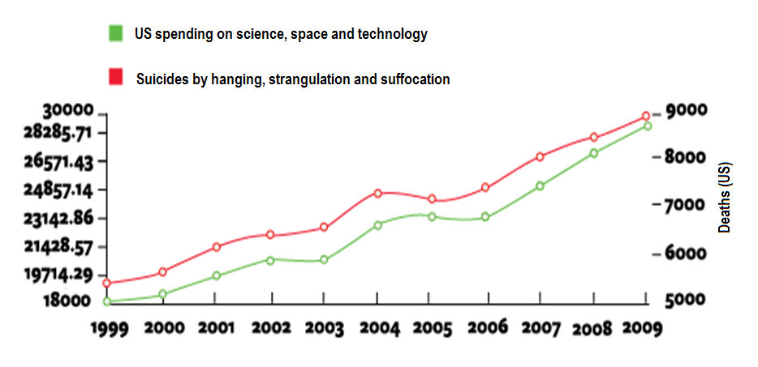
Driving suggestive relationships through visualizations
Spending (Millions)
Source: http://tylervigen.com/spurious-correlations
Notes:
Things wrong with the graph:
Comparing two unrelated things
Having two axes

Slide 8
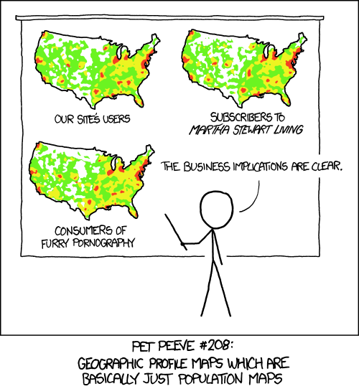
Driving suggestive relationships through visualizations
Source: https://xkcd.com/1138/

Slide 9
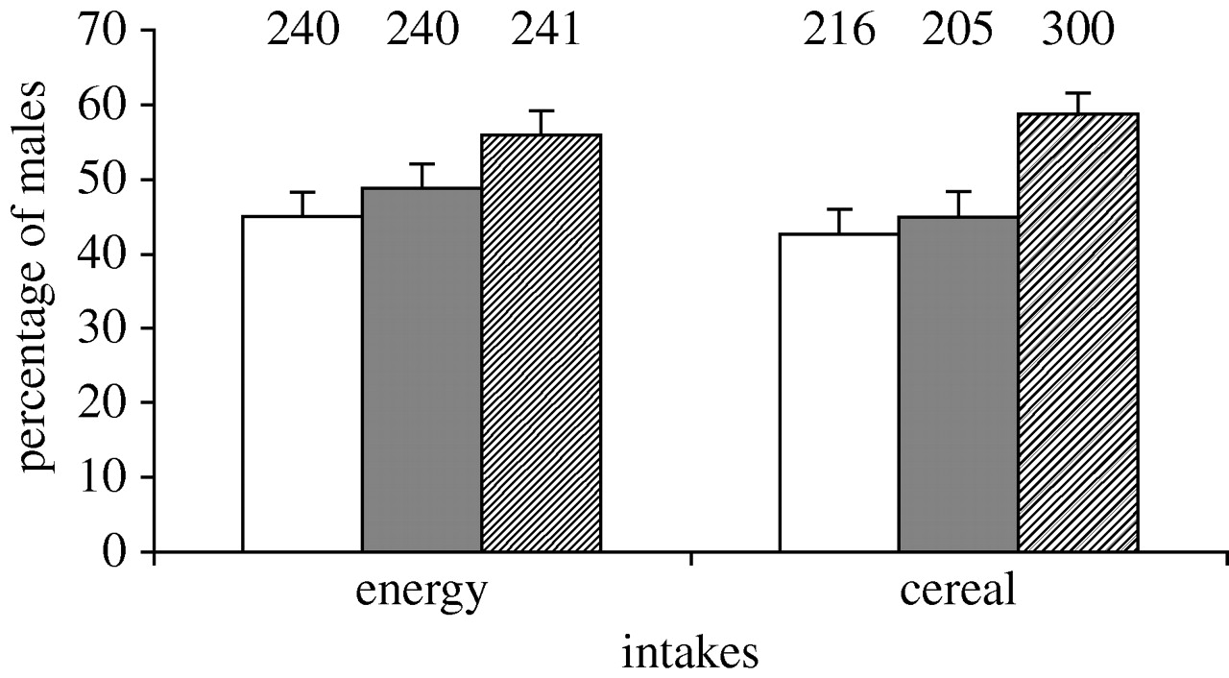
Let’s find the drivers of Conversions to Prime
Users in each group
Percentage of Conversions
Income group
Basket Size
Χ²=5.83, p=0.016
Χ²=13.96, p<0.001
Notes:
What would you say about the

Slide 10
Eating cereals can increase chances of getting a baby boy!
Women in each group
Percentage of Baby boys
Energy
Cereal
Χ²=5.83, p=0.016
Χ²=13.96, p<0.001
Source: http://rspb.royalsocietypublishing.org/content/275/1643/1661

Slide 11
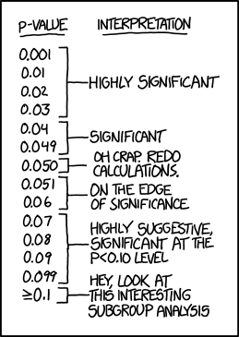
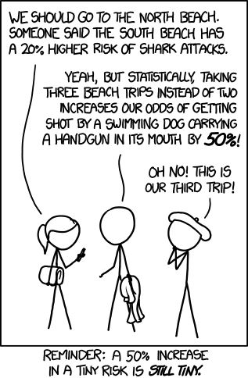
Source: https://xkcd.com/1478/
Source: http://derp.co.uk/xkcd/comics/increased_risk.png
Notes:
How can I lie with confidence ?

Slide 12


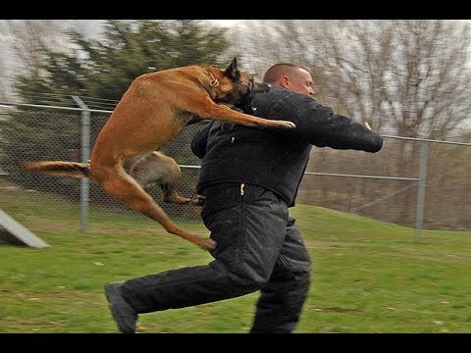
To give you a sense of how often this is !
Google couldn’t find two of the three things in the same picture.

Slide 13
Source:https://xkcd.com/1478/
Source: http://derp.co.uk/xkcd/comics/increased_risk.png
Notes:
How can I lie with confidence ?

Slide 14
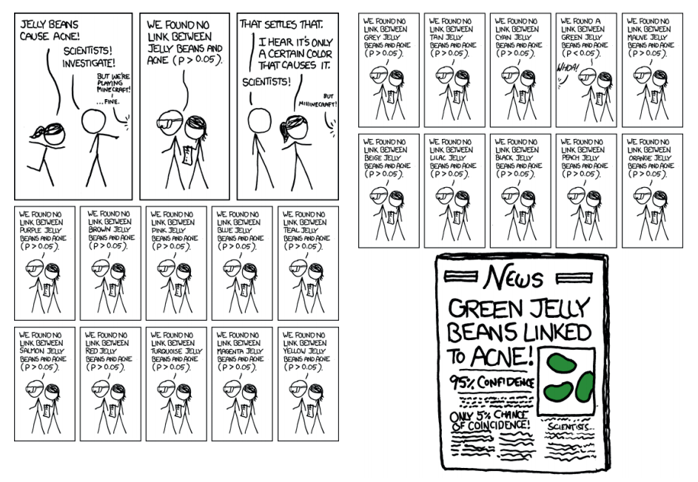
P-hacking
Source: https://xkcd.com/882/

Slide 15
Questions ?

Slide 16
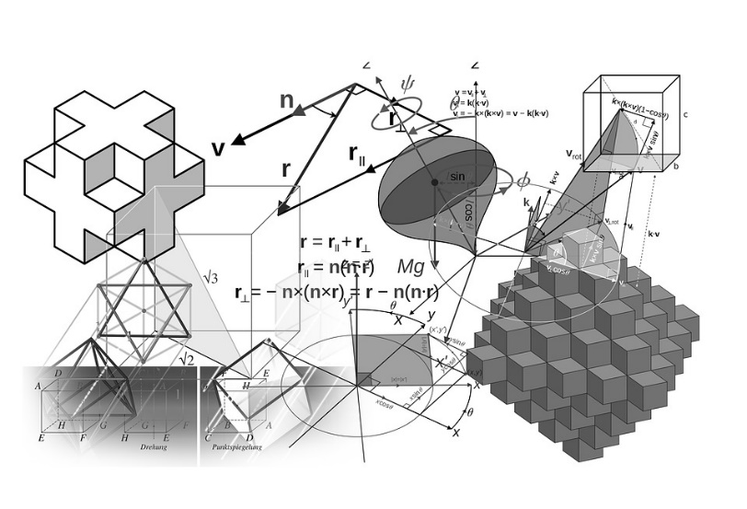
I lied when I said I’ll discuss four topics today !
Lying Using
Sophistication in Techniques
Notes:
Attend the Saturday learning hour Next Saturday, for a deep dive into how we can lie with statistics. We’ll go through a couple of use cases to see these in broader perspective. That will cover aspects of campaign measurement, modelling and establishing causality etc.

Slide 17
References
http://nautil.us/issue/19/illusions/five-ways-to-lie-with-charts
http://data.heapanalytics.com/how-to-lie-with-data-visualization
http://www.niss.org/sites/default/files/Young%20Karr%20Obs%20Study%20Problem.pdf

